Slide 1
Finite Differences:
Staggered Grids
Alex Matheson and Austin Nhung
Presentation 3
April 3, 2018

Slide 2
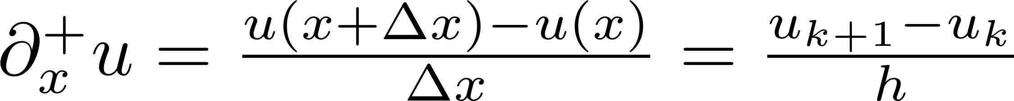
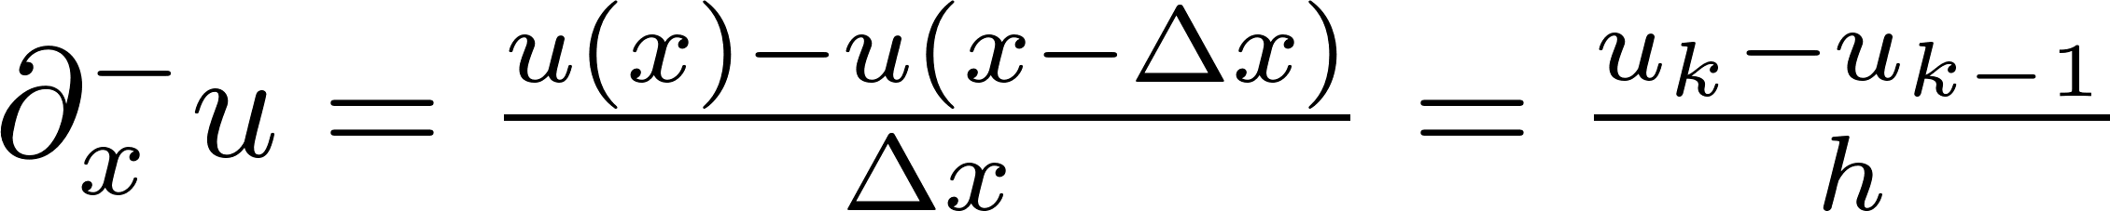
Review: Finite Differences
Finite differences is a way to evaluate differential equations discretely
There are a few different ways that finite differences may be performed:
Forward
Reverse
Centered

Slide 3
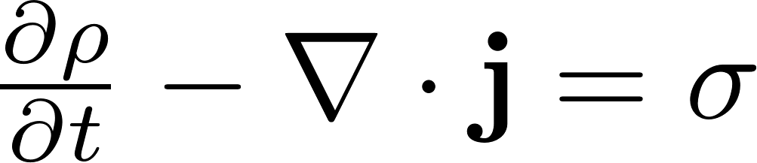
1st Order DEs
So far we have mainly dealt with DEs that are 2nd order in space.
1st order DEs have some peculiarities in terms of time effects
Ex: The Continuity Equation
ρ – quantity density j – flux σ - generation

Slide 4
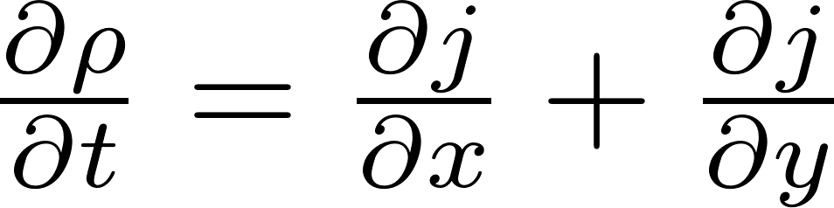
Continuity FDs
We want to minimize error, so we will use the central difference method in space, and the forward difference in time. We will consider the case where σ=0 in 2 space dimensions.

Slide 5

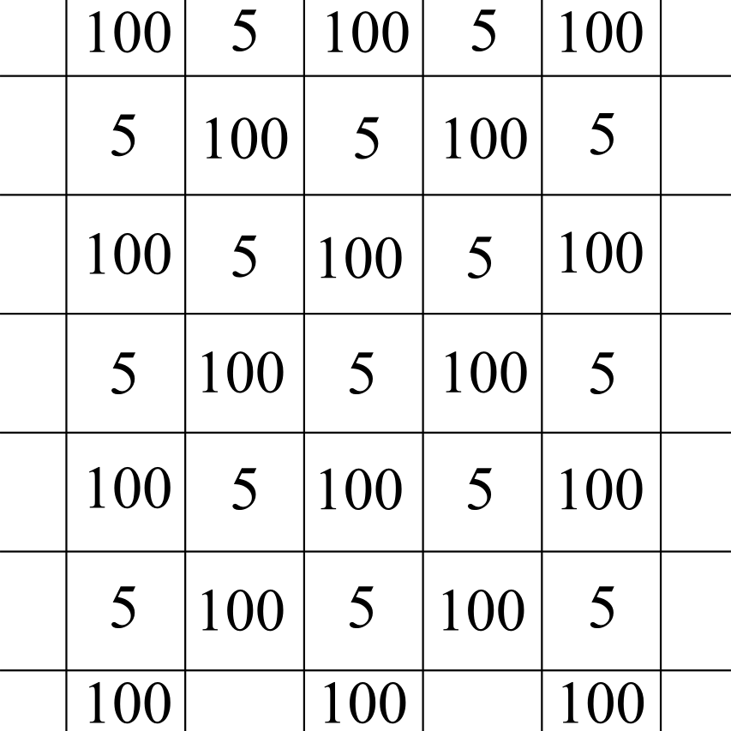
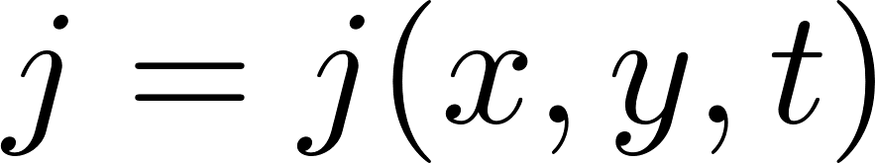
The Checkerboard Problem
Also known as odd-even decoupling
Consider some theoretical system where the flux has a known form:
Next, assume that when discretized, it oscillates between different values:

Slide 6
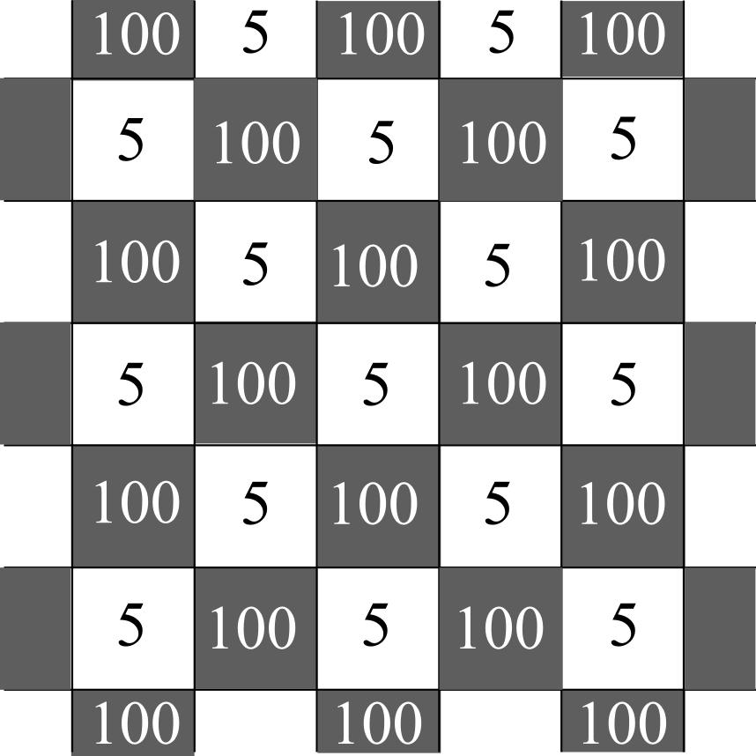
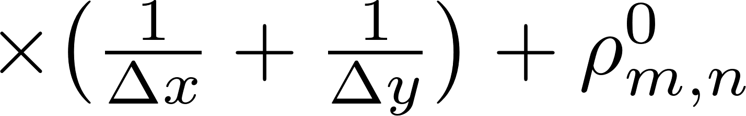
The Checkerboard Problem
This produces the most simplistic checkerboard pattern.
Analytically, we expect the density to behave as such:

Slide 7
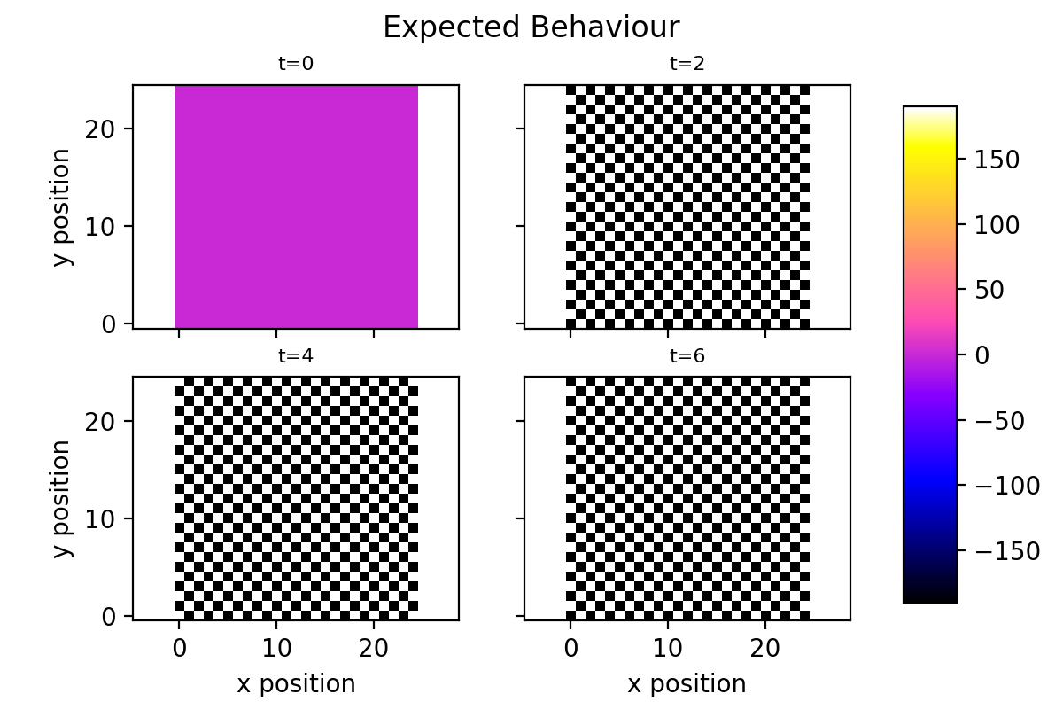
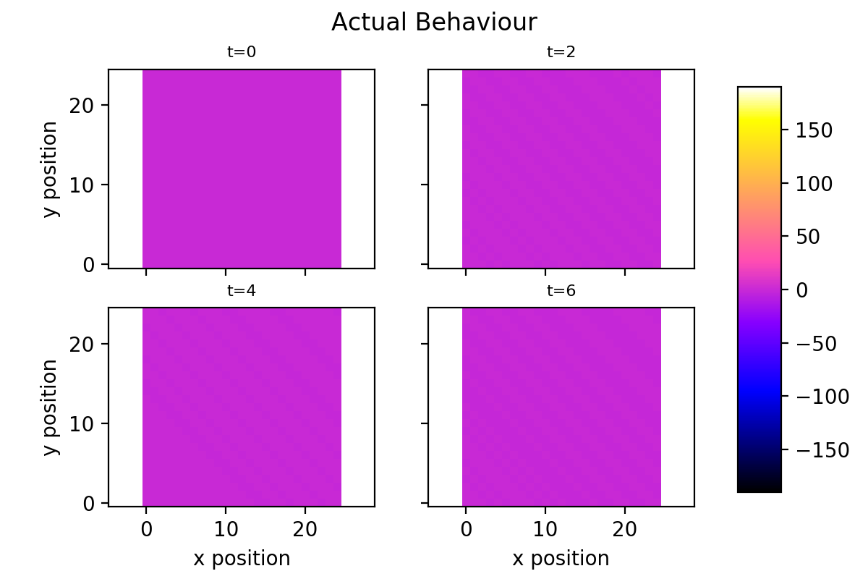
Testing Checkerboard
When we run our finite difference algorithm, the result isn’t what we expect.
It turns out our co-local coordinates respond poorly to high-frequency information and produce inaccurate results when exposed to high-frequencies

Slide 8
What’s Going On
Our 2 dimensional FD equation:
Our equation only looks at adjacent cells, not the current cell
If we are solving ρ for an ‘even’ cell, we are only looking at odd cells, and vice versa: we are odd-even decoupled

Slide 9
Checkerboard Consequences
Our checkerboard problem can occur anywhere there is alternating data. The same effect would occur if we forced ρ to oscillate and looked at j instead. Still more problems can occur if the pressure oscillates.
In the hydrodynamics case where some wave should dissipate, it may get stuck in a high-frequency state and remain in the simulation

Slide 10
Possible solutions
Increase the grid resolution
This is computationally inefficient
Use only forward or reverse finite differences, not the centered difference
This will increase error in our results and defeats the purpose
Use staggered grids
The accepted solution

Slide 11
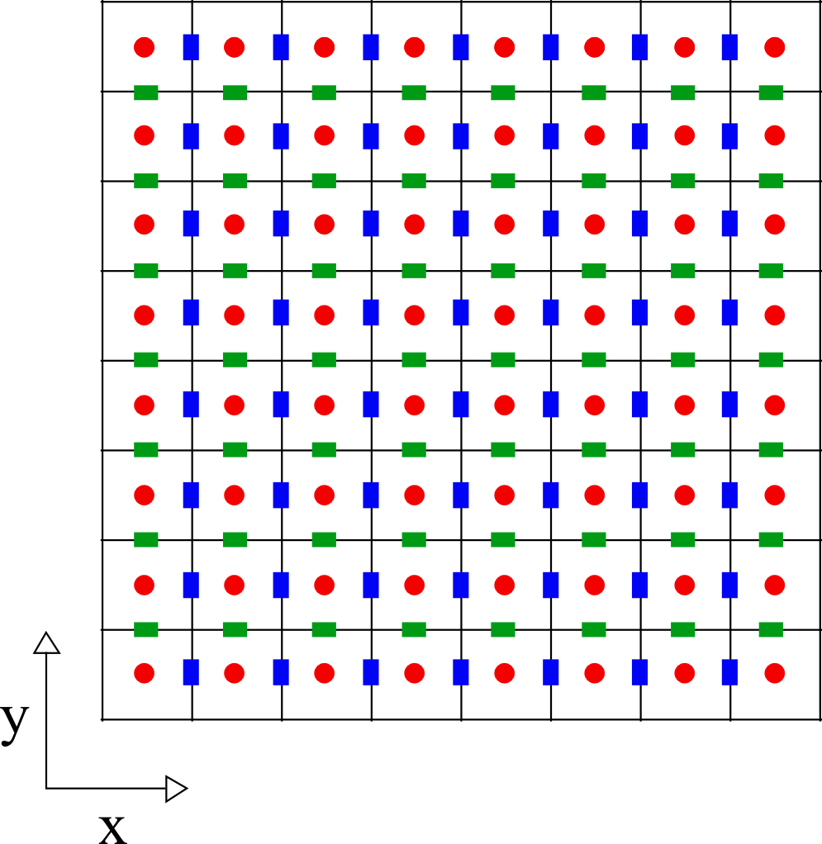
Staggered Grids
When we have differential equations that rely on 1st order derivatives, use multiple grids
One for the scalar quantity
Additional one for each vector, shifted a half-step from the scalar grid.
We can add further shifted grids for each additional first derivative

Slide 12
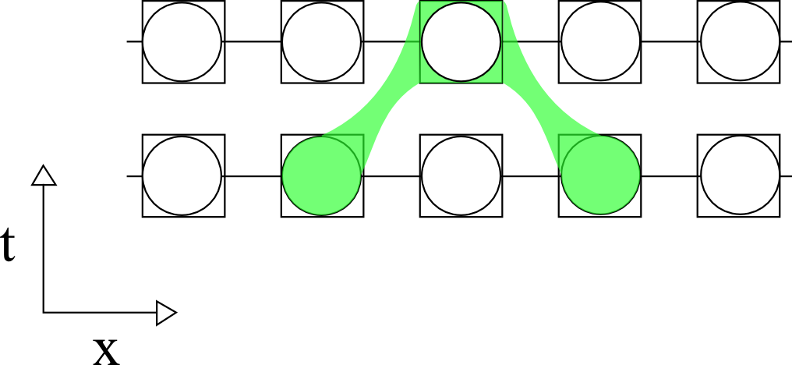
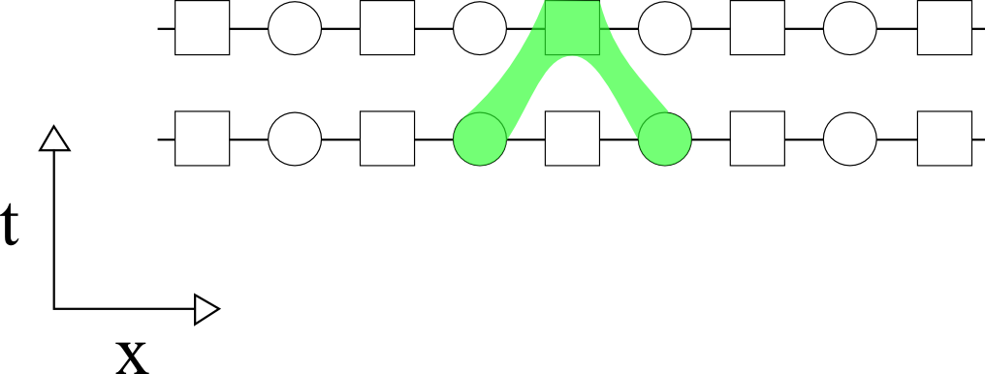
Stencils
Using the staggered grid method, we can effectively sample two adjacent points of our flux quantity
This uses the finite difference from a higher resolution while keeping the lower memory, lower resolution result

Slide 13

Checkerboard Revisited
We can re-attempt the checkerboard problem using staggered grids.
We can define a separate grid for the j values, with j_{m+1/2,n}^{l} in between ρ_{m,n}^{l} and ρ_{m+1,n}^{l} . Likewise, j_{m,n+1/2}^{l} is between ρ_{m,n}^{l} and ρ_{m,n+1}^{l}.
The result matches our analytical derivation

Slide 14
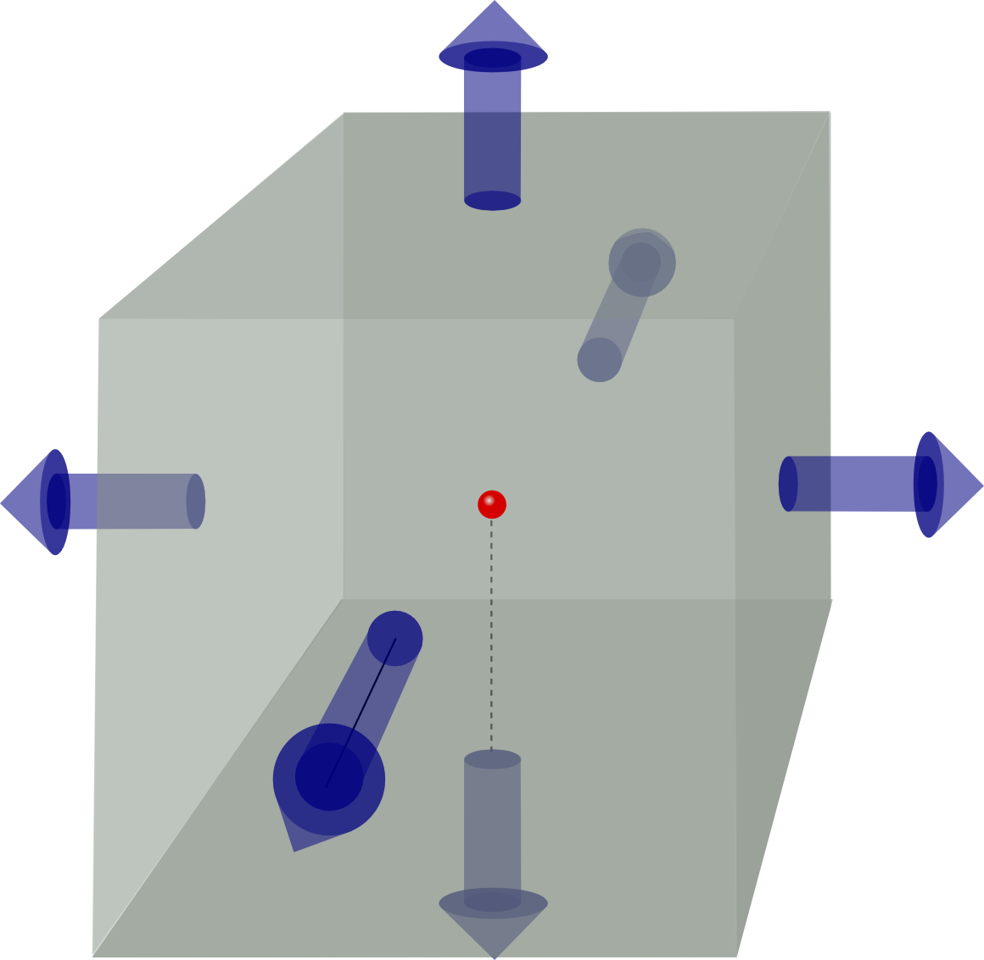
3D Grids
j_{y}
One benefit of staggered grids is intuitiveness.
Each cell acts as a cubic volume, with the quantity at the centre, and a flux at each of the relevant cell walls.
Some schemes with complicated sets of variables also place staggered values on cell edges, corners, etc.
j_{x}
j_{z}

Slide 15
Example: Shallow Water Equations
These equations are derived from Navier-Stokes equations (with simplifications)
$$\frac{dh}{dt} + H \left( \frac{du}{dx} + \frac{dv}{dy} \right) = 0$$
$$\frac{du}{dt} - fv = - g \frac{dh}{dx}$$
$$\frac{dv}{dt} + fu = - g \frac{dh}{dy}$$
Where h is the height of the fluid with velocities u and v in the x and y directions

Slide 16
Finite Difference Equations
$$\frac{h_{x, y}^{t+1} - h_{x, y}^{t}}{\Delta t} = - H \left( \frac{u_{x + \frac{1}{2}, y}^{t} - u_{x - \frac{1}{2}, y}^{t}}{\Delta x} + \frac{v_{x, y + \frac{1}{2}}^{t} - v_{x, y - \frac{1}{2}}^{t}}{\Delta t} \right)$$
$$ \frac{u_{x + \frac{1}{2}, y}^{t+1} - u_{x + \frac{1}{2}, y}^{t}}{\Delta t} = f v_{x + \frac{1}{2}, y}^{t} - g \frac{h_{x + 1, y}^{t} - h_{x, y}^{t}}{\Delta x}$$
$$\frac{v_{x, y + \frac{1}{2}}^{t+1} - v_{x, y + \frac{1}{2}}^t}{\Delta t} = - f u_{x, y + \frac{1}{2}}^{t} - g \frac{h_{x, y+1}^{t} - h_{x, y}^t}{\Delta y}$$

Slide 17
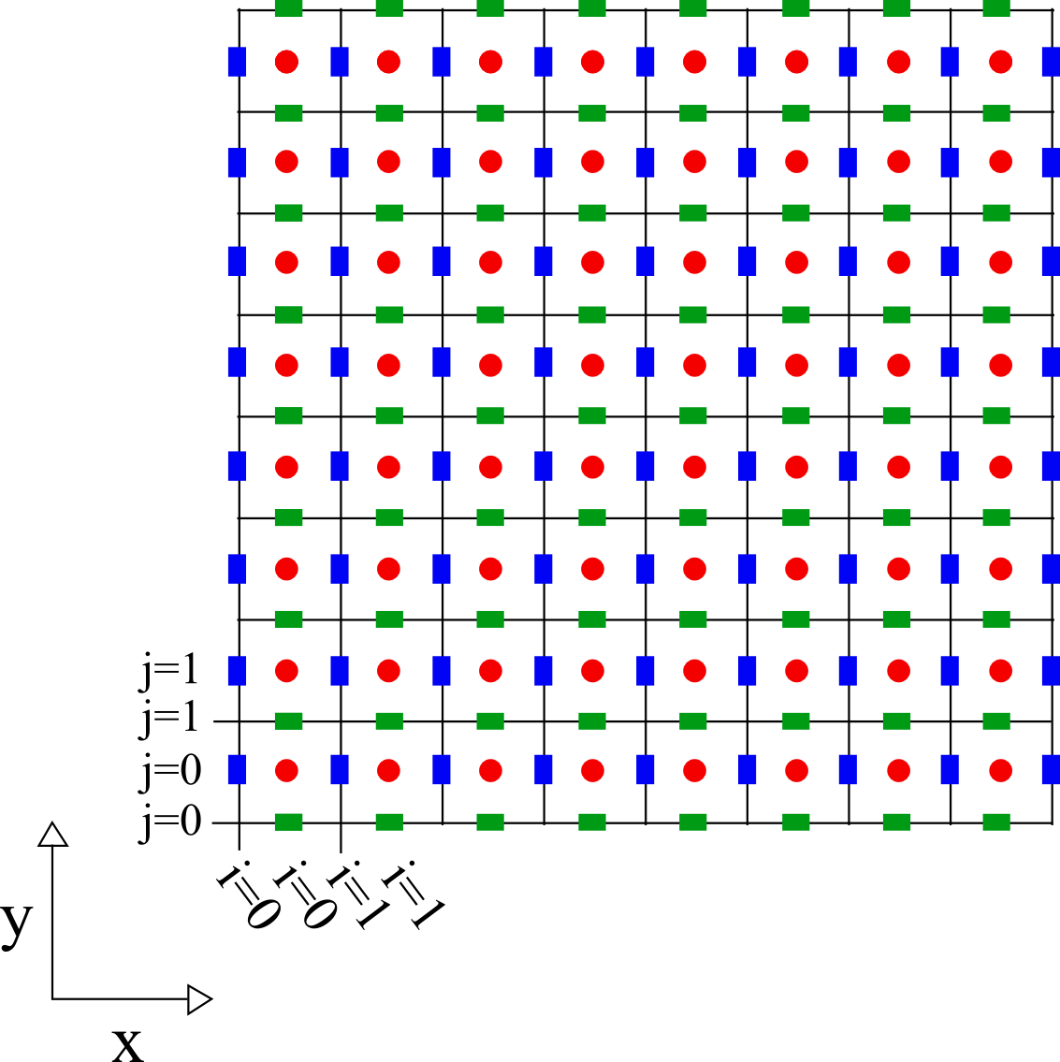
Setting Up Grids
Grids are created with ghost zones to set boundary conditions (in this case, boundary is zero)
Velocity grids are used on the boundary, so they are actually rectangles
The time derivatives depend of velocities depend on other velocity, so average is used

Slide 18
Results

Slide 19
Hydrodynamics
Hydrodynamics are also subject to conservation equations – of mass and momentum specifically
Hydrodynamics problems may be subject to high frequency components in shocks and sudden discontinuities – staggered grids are therefore preferred
The code provided in class uses a set of three grid systems: one for scalars, and two for vectors (one for each space dimension).

Slide 20
Hydrodynamics grid
Scalars – density(d) and pressure(p)
Indices for vectors run from 0 to N
Indices for scalars run from 0 to N-1
Example:
v1(i,j) is the x-velocity on the face between density values d(i,j) and d(i-1,j)
d(i,j) is the density between velocities v2(i,j+1) and v2(i,j)
X-velocity (v₁)
Y-velocity (v₂)

Slide 21
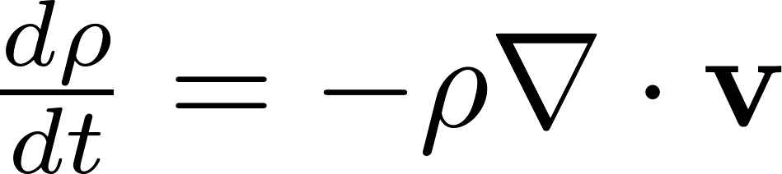
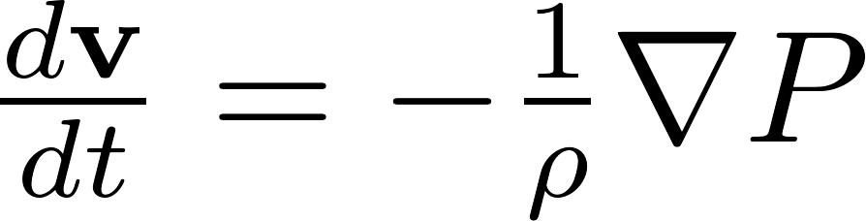
Navier-Stokes equations
Conservation of mass (Continuity):
Conservation of momentum (Euler’s Equation):

Slide 22
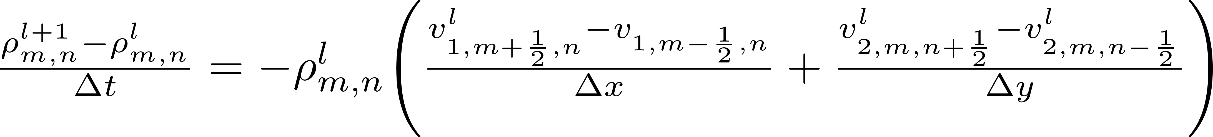
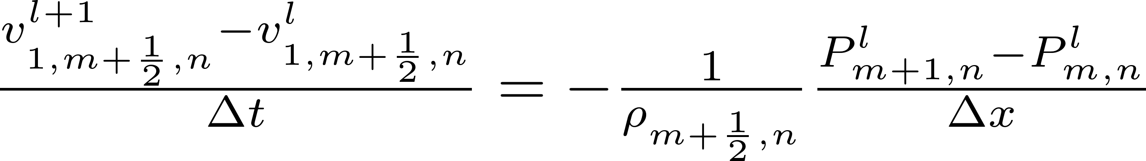
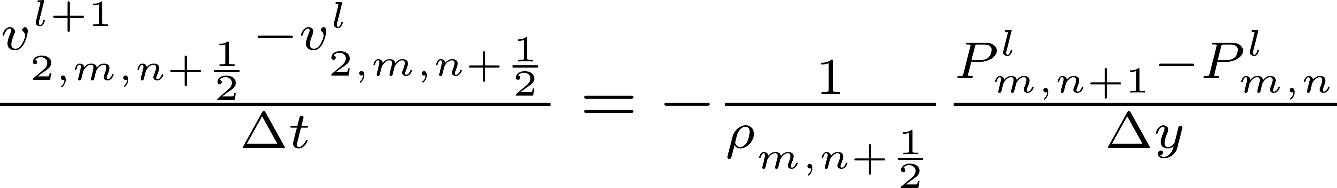
Navier-Stokes equations - FD
Conservation of mass (Continuity):
Conservation of momentum (Euler’s Equation):
Uh-oh

Slide 23
Mixed-Grid Problem
So far in our general conservation equations and E&M equations, our different variables have always been related through a derivative
Where our FD equation for dv depends on ρ and not dρ, we need a value of ρ at a location off its grid.
We could subdivide the ρ grid, but at that point we re-introduce our original frequency problem. We can’t stagger more, as that would require ad-infinitum staggering.
We can use interpolation in some situations: this won’t work when there are shocks or discontinuities in the data

Slide 24
Staggered vs. Co-Local
While staggered grids are a common hydrodynamic method, some programs choose to use co-local. Below is a comparison of each.
Co-Local Grids | Staggered Grids
Intuitive Indices | Careful tracking of indices required: 3D spaces are particularly easy to mis-label
Evaluating Flux at the middle of a cell is unideal: we would prefer to evaluate it on a surface | Intuitive volumetric structure: flux occurs on cell walls
Odd-even decoupling may occur | Solves odd-even decoupling
Co-local grids make solving conservation of momentum easy | Staggered grids require some estimate of density at cell walls – may be very difficult

Slide 25
Summary

